Slide 1


Angular
Aruna S
Department of
Computer Science and Engineering

Slide 2

angular
Angular Forms and Template Forms
S. Aruna
Department of Computer Science and Engineering

Slide 3
Angular
Angular Forms
Angular takes two approaches to build the forms. One is Template-driven forms approach and another one is Reactive forms or model-driven forms approach.
Template-driven forms approach
In Template – driven approach is the easiest way to build the Angular forms. The logic of the form is placed in the template.
Model-driven forms approach
In Reactive forms or model-driven approach, the logic of the form is defined in the component as an object. The Model-driven approach has more benefits as it makes the testing of the component easier. In this approach, the representation of the form is created in the component class. This form model is then bound to the HTML elements.

Slide 4
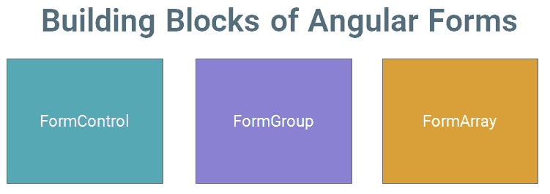
Angular
Angular Forms
Template driven forms in Angular allows us to create sophisticated looking forms easily without writing any javascript code. The model-driven forms are created in component class, where Form fields are created as properties of our component class. This makes it easier to test.
The Angular Forms module consists of three Building blocks, irrespective of whether you are using Template-driven or Reactive forms approach.

Slide 5
Angular
Angular Forms - Form Control
A FormControl represents a single input field in an Angular form.
Consider a simple Text input box
First Name : <input type="text" name="firstname" />
The FormControl is an object that encapsulates all this information related to the single input element. The FormControl is just a class. A FormControl is created for each form field. We can refer them in our component class and inspect its properties and methods
The above input field is created using the FormControl as shown below
let firstname= new FormControl();
Then, you can retrieve the current value in the input field using the value property
firstname.value

Slide 6
Angular
Angular Forms - Form Group
FormGroup is a collection of FormControls . Each FormControl is a property in a FormGroup. with the control name as the key.
Often forms have more than one field. It is helpful to have a simple way to manage the Form controls together.
let address= new FormGroup({
street : new FormControl(""),
city : new FormControl(""),
pinCode : new FormControl("")
})
Here the address is FormGroup, consisting of 3 Form Controls city, street, and Pincode.

Slide 7
Angular
Angular Forms - Form Array
FormArray
FormArray is an array of form controls. It is similar to FormGroup except for one difference. In FormGroup each FormControl is a property with the control name as the key. In FormArray is an array of form controls.
Example:
contactForm = new FormGroup( {
name: new FormControl(''),
cities:new FormArray([
new FormControl('Mumbai'),
new FormControl('Delhi')
])
});

Slide 8
Angular
Angular Forms – Template Driven forms
In Template Driven Forms the behaviors/validations are specified using directives and attributes in template .
All things happen in Templates hence very little code is required in the component class. This is different from the reactive forms, where we define the logic and controls in the component class.
The Template-driven forms
The form is set up using ngForm directive
controls are set up using the ngModel directive
ngModel also provides the two-way data binding
The Validations are configured in the template via directives

Slide 9
Angular
Angular Forms – Template Driven forms
Template-driven forms are
Contains little code in the component class
Easier to set up
While they are
Difficult to add controls dynamically
Unit testing is a challenge
Import FormsModule
To work with Template-driven forms, we must import the FormsModule. We usually import it in root module or in a shared module. The FormsModule contains all the form directives and constructs for working with forms
ngForm
Once, we have a form with few form elements, the angular automatically converts it into a Template-driven form. This is done by the ngForm directive.
The ngForm directive is what makes the Angular template-driven forms work.

Slide 10
Angular
Angular Forms – Form Validations
The Built-in validators use the HTML5 validation attributes like required, minlength, maxlength & pattern. Angular interprets these validation attributes and add the validator functions to FormControl instance.
Adding in Built-in Validators
Required Validation
Minlength Validation
Maxlength Validation
Pattern Validation
Email Validation
Disable Submit button

Slide 11
THANK YOU
Aruna S
Department of
Computer Science and Engineering
arunas@pes.edu

